Slide 1
CEIS150 Module 2
Class Diagrams
Class Coding
Unit Testing
Professor: Dr. Omar Haddad
Student: . B. Lee Ecke

Slide 2
Rubric
Activity | Requirement(s) | Points
Class Diagram | Class Diagram | 10
Class Code | Screen Shot of Class Code | 15
Unit Test | Screen Shot of Unit Test | 15
2

Slide 3
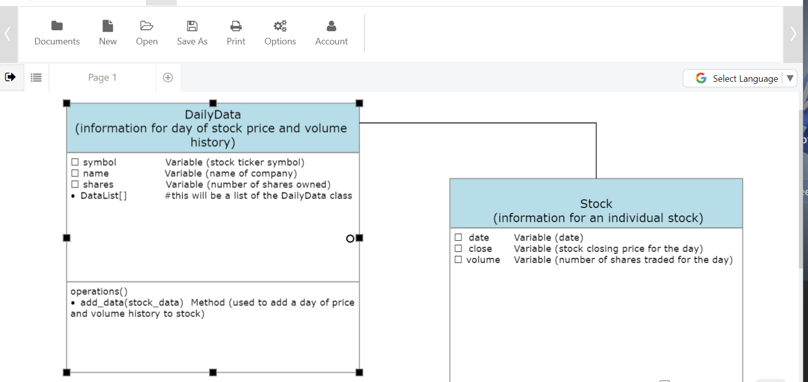
Class Diagram
3

Slide 4
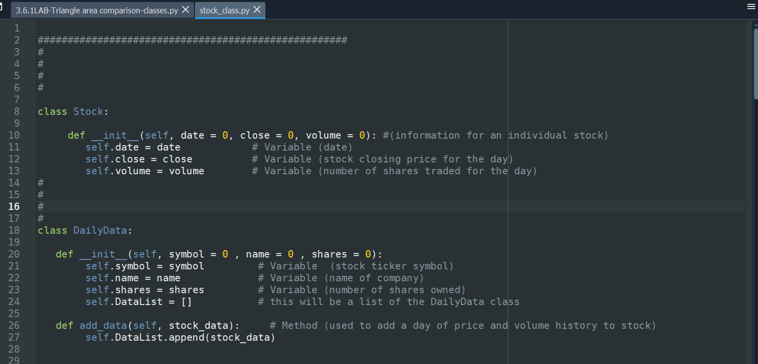
Class Code
4

Slide 5
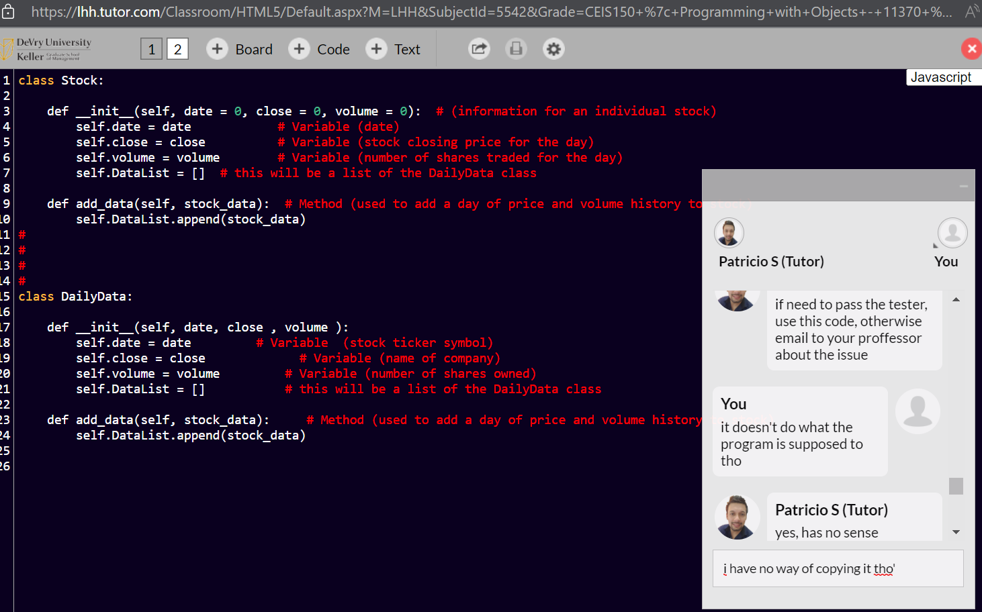
Tutor ‘s Session
5

Slide 6
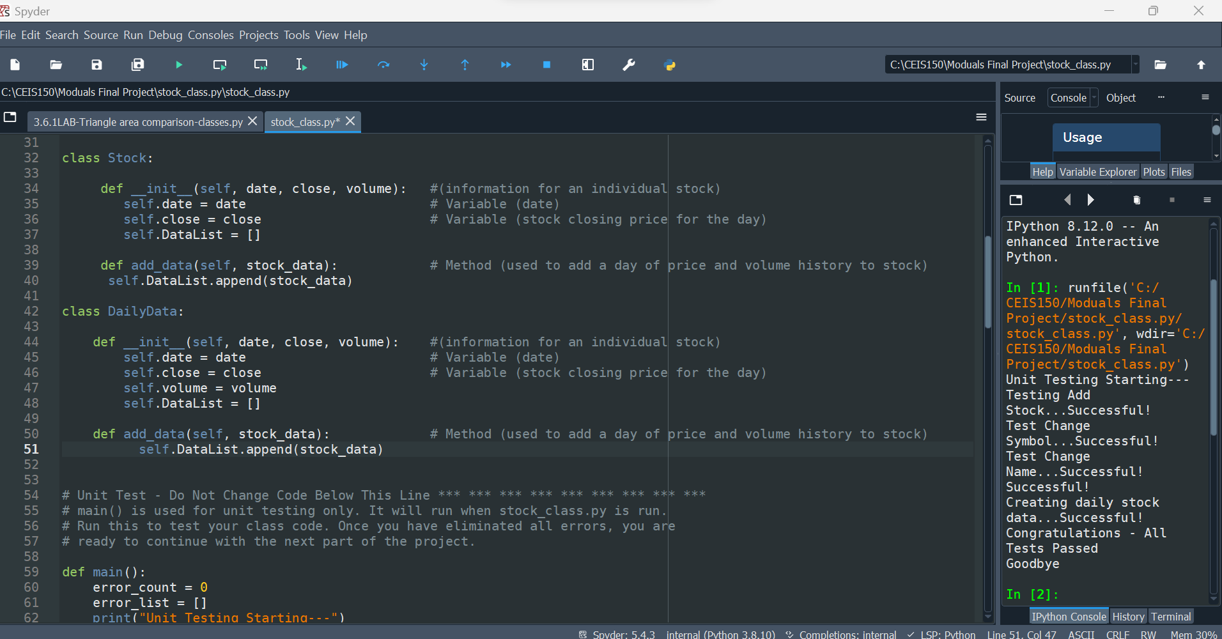
False Unit Test
6

Slide 7
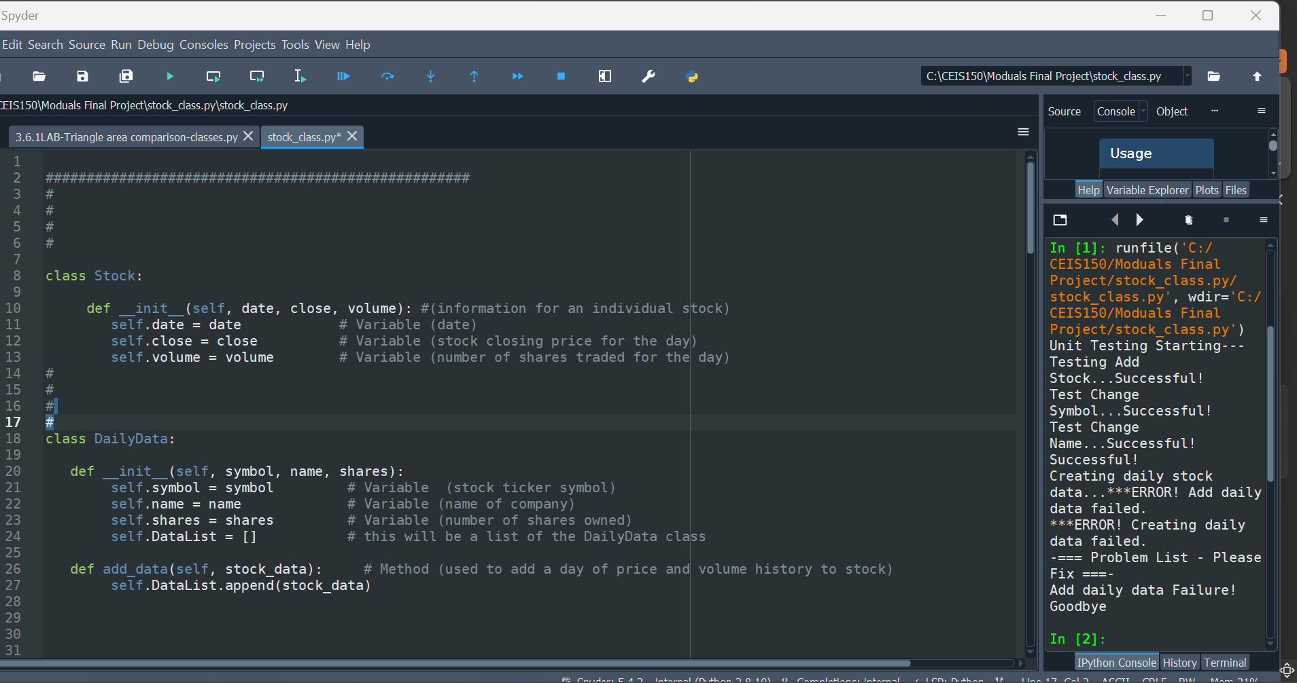
My Unit Test
7

